Slide 1
Notes

Slide 2
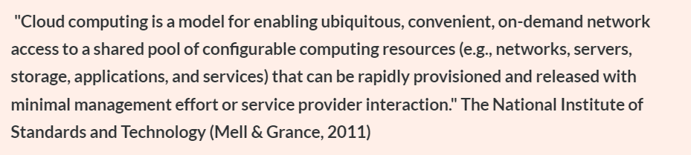
Introduction
In the last decade, the increase in data has resulted in some problems for businesses and consumers regarding maintenance, storage and security.
To constantly manage and maintain digital data accurately can be expensive to find the resources required.
The solution to these issues has come in the form of cloud computing and cloud security
According to Patrick (2016), over 90% of businesses in the US now use some cloud service to manage, store and protect their data.

Slide 3
Introduction
The CSP (Cloud Service Provider) offers IT infrastructure and resources to organisations. Organisation pay per usage of these computing resources provided in the cloud.
The cloud removes the need to invest in in-house computing resources.
Cloud computing reduces administration
These benefits are the main reasons many companies gravitate towards cloud computing

Slide 4
Drawbacks to using Cloud
Service Outage
Limited Flexibility and Control
Vendor Lock in
Security

Slide 5
Security breach throughout the years
The following examples show that security can be a primary risk of using cloud computing.
In 2012, Dropbox announced that they had 69 million user accounts hacked, and someone stole the users' details (Bradford, 2019).
In 2014, someone hacked Apple iCloud, and they exposed several celebrities private photos to the Internet.
In 2016, someone stole nearly 170 million email addresses and passwords from the LinkedIn social media platform (Bradford 2019).

Slide 6
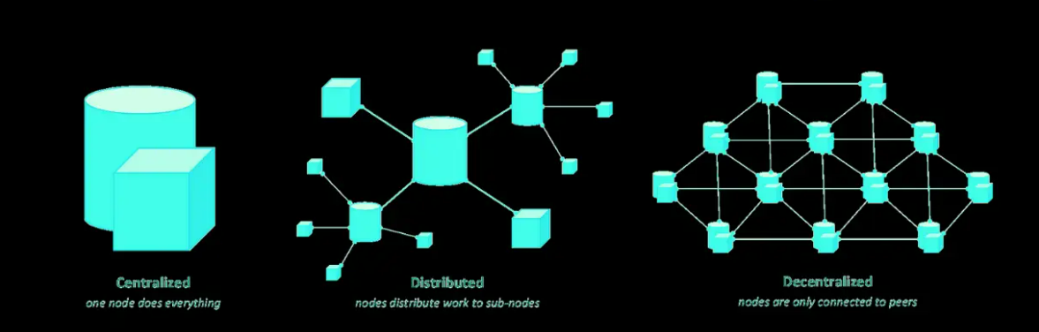
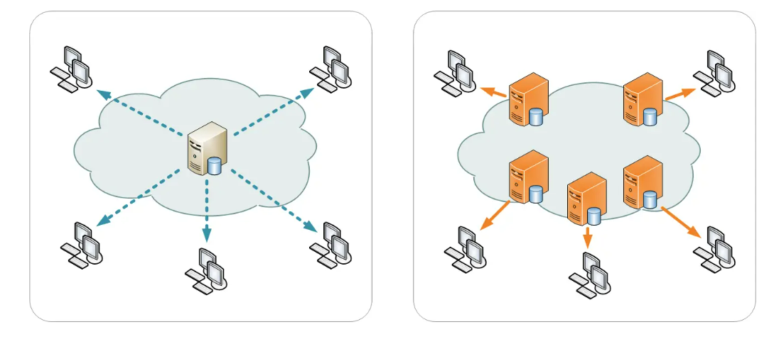

Slide 7
Benefits to using Cloud
Centralised Security
Less Administration
More Reliability
Cost Reduction

Slide 8
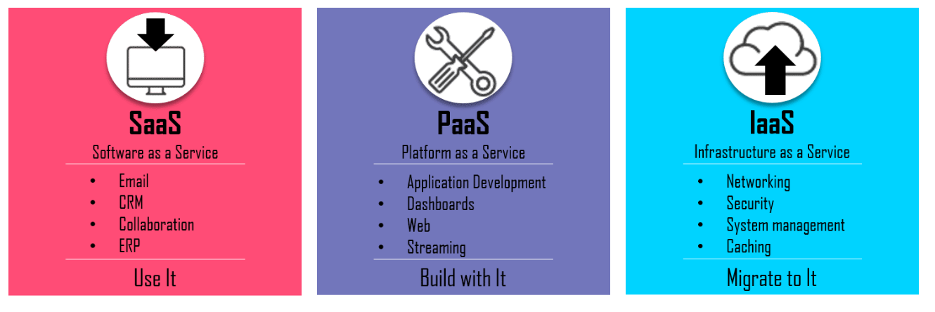
Service Models

Slide 9
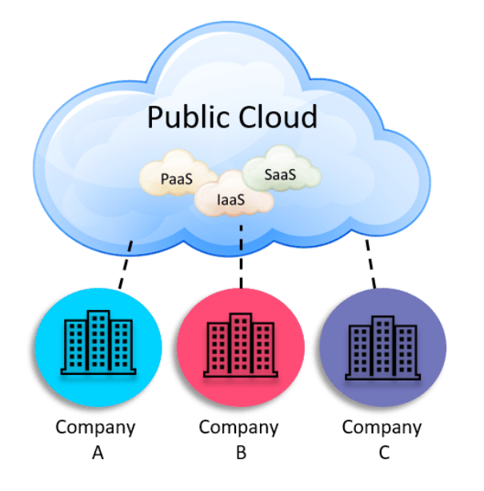
Deployment Models
Public cloud: Any of the resources in the public cloud pool is accessible to anyone via the Internet.

Slide 10
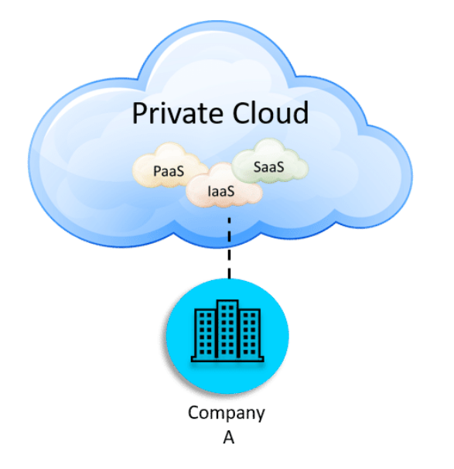
Deployment Models
Private cloud:In private cloud they do not share the pool of resources between multiple clients.

Slide 11
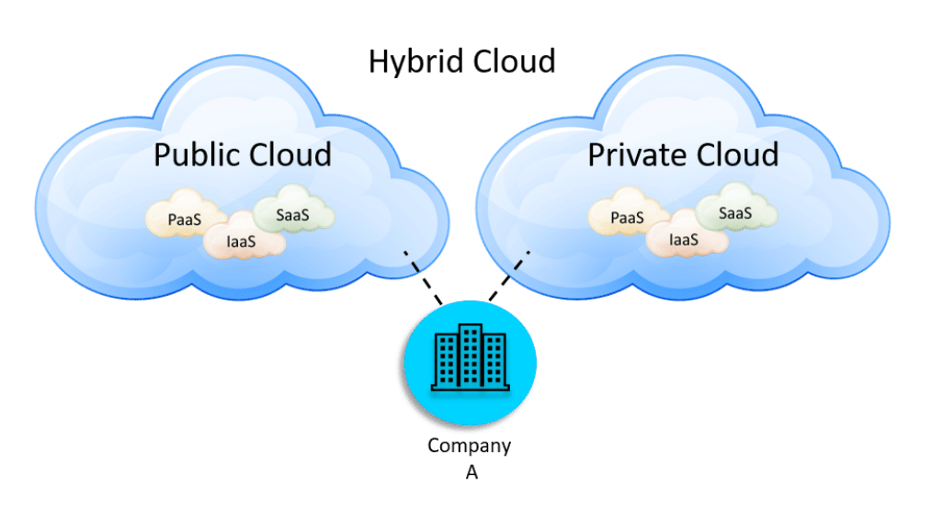
Deployment Models
Hybrid cloud:A hybrid cloud is a mix of both public and private clouds.

Slide 12
Specific Security Concerns
Saas Security Concerns:SaaS are the most popular services offered in public clouds.
Wide range of concerns and risks, mostly related to data and access. Some of the most important ones are:
The lack of ability to comply with regulatory compliances. For instance, the regulations in certain countries allows them to store confidential data collected from hospitalised patients to a public cloud. (For instance, Microsoft has set up a protected government cloud level of service in Australia as have AWS for the US government).

Slide 13
Saas Security Concerns
Lack of control on the security management of the public clouds.
Higher probability of cyberattacks because of the exposure of cloud resources to the public via Internet
Higher probability insider data breaches.
Difficulty tracking data transfer to and from the cloud resources.
Lack of visibility of users, data access, and applications in the cloud provider.
Visibility is the ability to have a detailed view of all activity.

Slide 14
PaaS & IaaS Security Concerns
The lack of monitoring ability on a loud workload system and its applications
Difficulty maintaining consistent security control across multiple clouds and platforms
Higher probability of insider data breaches.
Lack of data visibility in the cloud
Lack of control on the users and access grants to the cloud
Bypassing authentication and encryption
Hacking and attacks
Abusing cloud services

Slide 15
General Security Concerns
In the traditional IT infrastructure, each company has a data centre administrated by an in-house IT team.
When a company migrates data to a cloud: the cloud provider manages the security.
Many people consider this absence of in-house control a downside of a cloud.
When using private or hybrid clouds, they allocate dedicated pools of resources to a company, so there is less concern about public access.

Slide 16
General Security Concerns
Cyber Attacks:
Insider Security Breaches: For instance, in 2013, someone stole two million Vodafone customer records (Mimoso, 2013). A contractor in Germany did this. Such threats always exist, and the clients of clouds have no control over them. If they get access to the cloud, they can steal confidential data, passwords, and intellectual property.

Slide 17
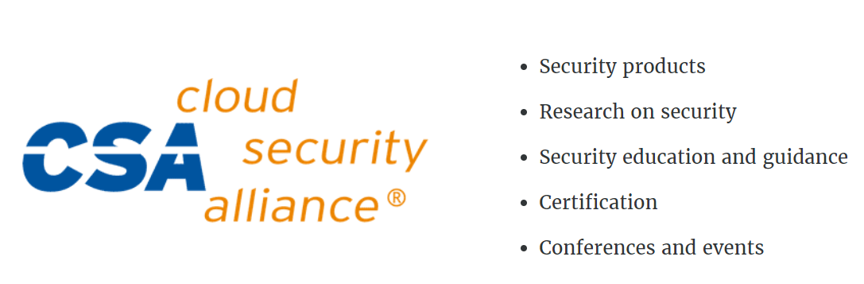
Cloud Security Alliance (CSA).
CSA is a non-profit organisation, and their mission is “promote the use of best practices for providing security assurance within Cloud Computing, and to provide education on the uses of Cloud Computing to help secure all other forms of computing.
The services that CSA offers to the world are:

Slide 18
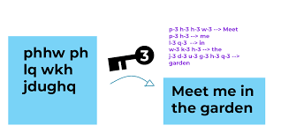
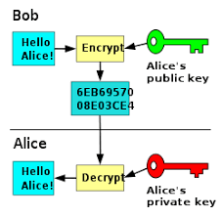
Cloud Security Techniques
It includes a wide range of preventive, detective, and corrective methods and activities to make the resources in the cloud secure.
Authentication software
Encryption

Slide 19
Cloud Security Techniques
Data integrity ensures that data represents what we expect it to represent. One of the most widely used methods to ensure data integrity is to use ALOCA:
Attack Solution: ransomware attacks, Denial of Service Attack, malware injection attack, phishing attack, etc.
Attributable | Legible
Contemporaneous | Original
Accurate

Slide 20
Cloud Security Best Practices
If you want to use any cloud services or work in cloud computing companies, the following best practices will ensure safe and reliable services.
Tools
Audits
Policies
Enforcement
Training
Responsibility

Slide 21
Shared responsibility model
Traditional IT models relied on an approach that security is the sole responsibility of the organisation however, in cloud computing services, security is a combined responsibility.
Cloud providers handle and treat risks through a shared responsibility model.
There are seven security areas shared between the cloud provider and client.

Slide 22
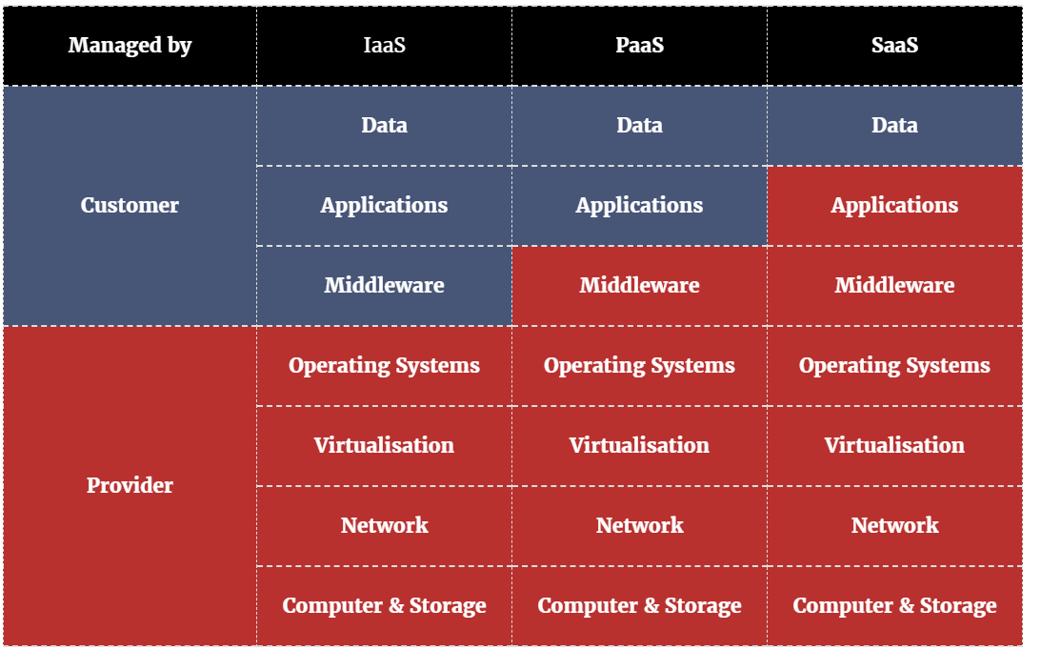
Shared responsibility model

Slide 23
Responsibilities Defined
User security refers to any preventive, protective, detective, and corrective security activates done at the user level.
Data Security: Here we need to ensure that we protect and secure the data. The three most important aspects of data security are:
Integrity
Availability
Confidentiality

Slide 24
Responsibilities Defined
Application Security
Middleware security
Operating System
Virtualisation security
Infrastructure security: They divide infrastructure security into network security and physical security.
Network security
Physical security

Slide 25
Common Cloud likely attacks.

Slide 26
Hack 1: The Little Phish: The Password is Catch of the Day
Phishing is still unbelievably popular with cyber criminals.
Why? It works.
According to the Verizon Data Breach Investigation Report (DBIR), 30% of people opened phishing messages in 2016. Almost one-third of people open phishing messages!

Slide 27
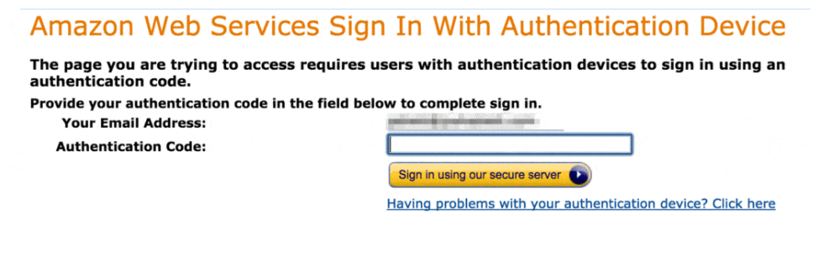
The Fix to Achieve Secure Cloud Computing:
Turn on two-factor authentication (2FA).
Here's how 2FA works.

Slide 28
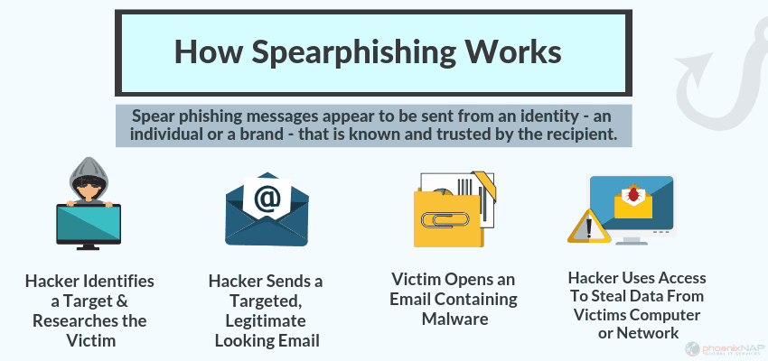
Hack 2: The Big Phish: You’ve Been Speared
https://ondefend.com/2020/05/06/stop-spearphishing-attacks/

Slide 29
The Fix to Achieve Secure Cloud Computing:
Having root access is like having the keys to the kingdom.
Instead, you should create separate accounts with the proper privileges.
Change the root password to something long and complicated.
Root Access is an administrator level log-on for Dedicated Servers, Cloud Servers, VPS Hosting.

Slide 30
Hack 3: Passwords, Passwords, Everywhere Does Not Help Secure Cloud Computing
Tons of people use the same password across multiple sites. Research has shown that around 55% of adults use the same password across multiple sites. Yikes!

Slide 31
The Fix to Achieve Secure Cloud Computing:
This one's easy. Use a UNIQUE password for your AWS account. Better yet, use a password manager so you can get strong, unique passwords that are easy to remember.

Slide 32
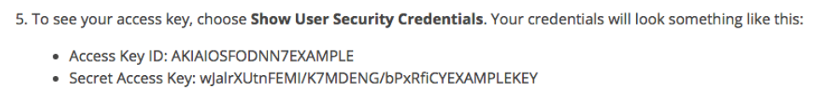
Hack 4: The Keys to the Kingdom
AWS uses access keys to allow technical users to control cloud servers. These are strings of data that let users get to their machines without a username or password.
These are literally the keys to your AWS kingdom.

Slide 33
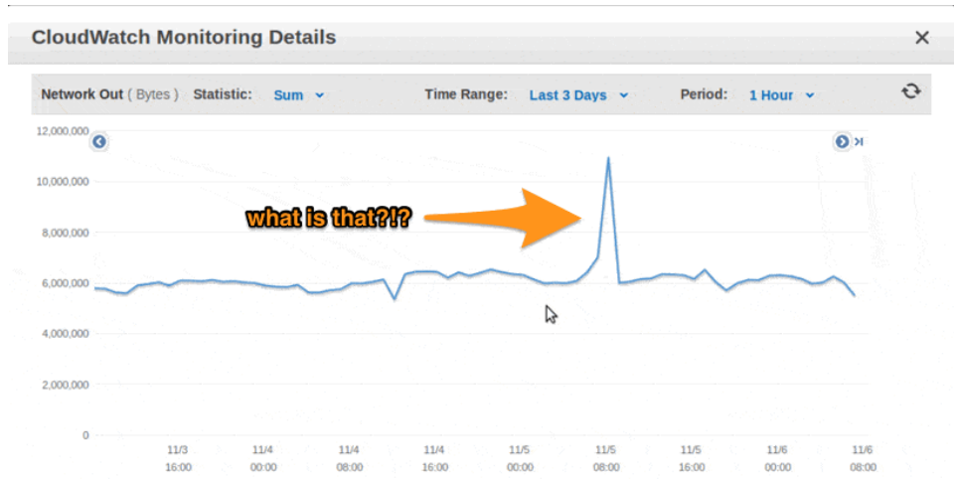
The Fix to Achieve Secure Cloud Computing:
First, train your people on proper handling of keys.
Second, set up monitoring and alerts. Amazon offers a monitoring service called CloudWatch.
Third, set up specific AWS billing alerts.

Slide 34
Hack 5: Oops, GitHub Exposure
Developers accidentally upload their AWS access keys to sites like GitHub.
This exact scenario happened to Andrew Hoffman. Andrew had published some code to GitHib for securing Ruby apps. He also published his AWS access keys at the same time. In his case, the cybercriminals had added 140 new servers to his account and used them to mine litecoins.

Slide 35
The Fix to Achieve Secure Cloud Computing:
Consider using temporary access keys in their best practice for access keys guide.
Also, have some strict policies and monitoring around sites

Slide 36
Hack 6: Where’s Waldo?
The OWASP (Open Web Application Security Project) top ten guidance
Waldo: a remote-controlled device for handling or manipulating objects.

Slide 37
The Fix to Achieve Secure Cloud Computing:
AWS gives you a strong control to fight web application attacks
"Security Groups."
Web Application Firewall

Slide 38
Hack 7: Advanced Attack? Nuke from Orbit
"Advanced Persistent Threat."

Slide 39
The Best Defense is a Good Offense
Create a solid, robust backup strategy: Revert back to known good servers and data.
Create multiple backups.
Different tiers of storage all work together to create a robust backup strategy. Services at AWS like EBS, S3, and Glacier balance speed and cost.

